Slide 2


Hyperledger Iroha
Presented by:
Pushkar Sunilkumar Nikumb
TE_B_47
Guided by : Prof. Yogita Bhise Madam

Slide 3

Hypledger Iroha Permissioned Blockchain Framework

Slide 4
Table of Context
Introduction
Hyperledger Foundation
What is Hyperledger Iroha
How it differs from Bitcoin and Ethereum
Key Features of Iroha
Basic Terminologies/ Core Concepts
Iroha Architecture
Use Case Scenarios
Bibliography

Slide 5
Introduction
Why Business and Financial Ecosystem required Blockchain?
Ans: Blockchain is helping transform business around the world. Greater trust leads to greater efficiency by eliminating duplications of effort.
Blockchain brings revolution in supply chains, food distribution, government, retail, etc. Businesses are now more secure and thus store and transfer records using Blockchain technology with strong Encryption.

Slide 6
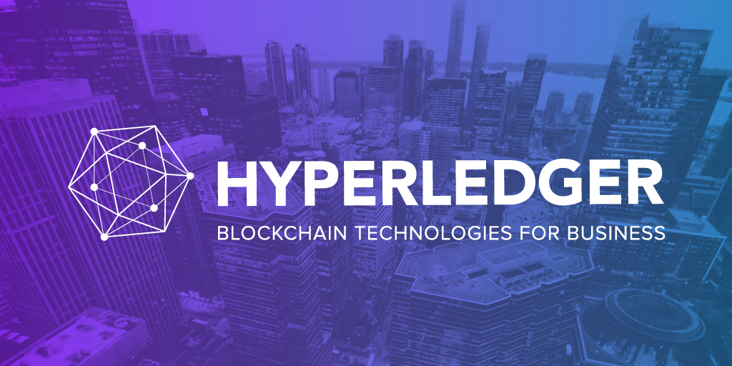

Slide 7
1. Hyperledger Foundation
Hyperledger is an open source Consortium for developing Bussiness Blockchain Technology hosted by Linux Foundation.
Within Hyperledger Greenhouse, diverse communities collaboratively develop open source projects, that uniquely approaches Enterprise Blockchain Challenges

Slide 8
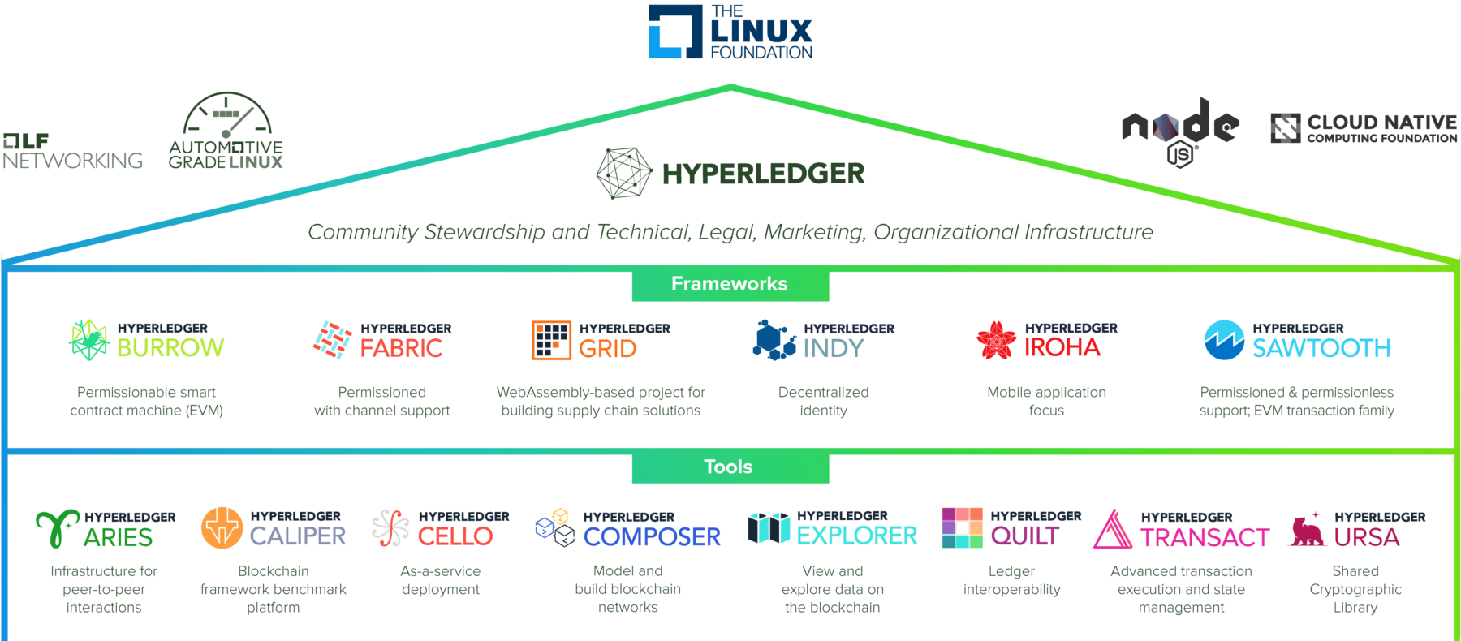

Slide 9


Slide 10

What is Hyperledger Iroha
Hyperledger Iroha is a Business Blockchain Framework designed to be incorporated in various Business uses and Infrastructure projects that need Distributed Ledger Technology.
Their ultimate aim is to create a DLT that enables organizations to build and run robust, industry-specific applications to support individual business transactions.

Slide 11





Launched in 2019, Hyperledger Iroha is one of the projects developed under the Hyperledger Umbrella, hosted by Linux Foundation
The Japanese company, Soramitsu Co. Ltd., has open sourced the code for Iroha.
This framework was developed in C++ and supports multiple languages like Java, Javascript, Swift, Python and multiple O.S like Windows, Linux, macOS.

Slide 12
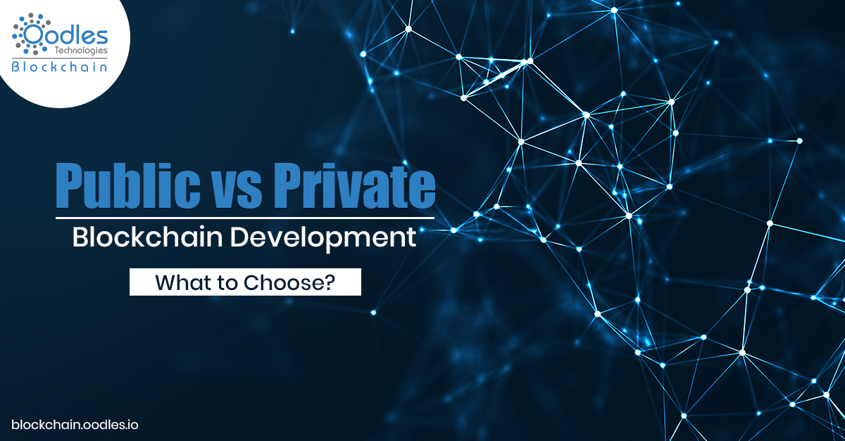

Slide 13
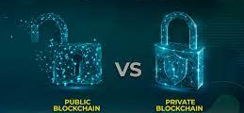
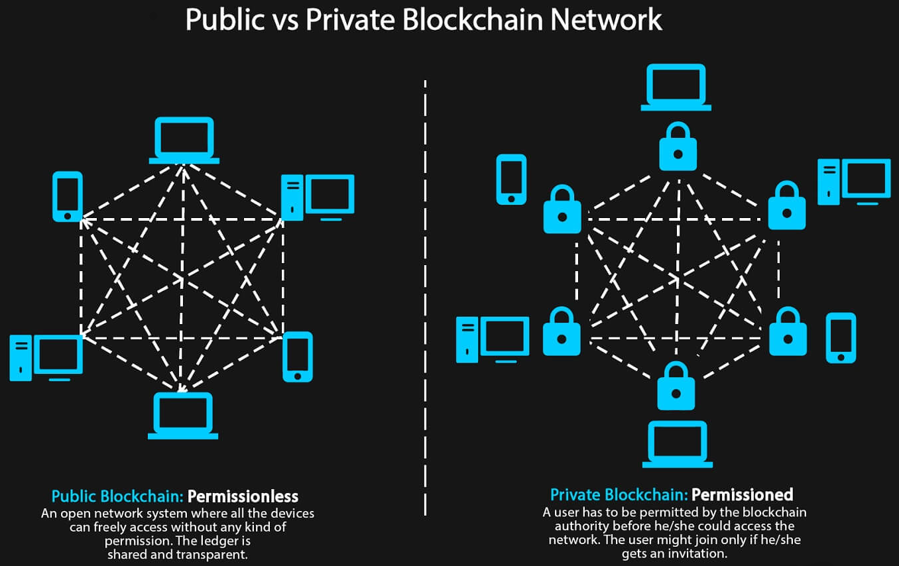
Public v/s Private Blockchain Platforms
Hyperledger Iroha is different from other popular Blockchain platforms, like Bitcoin and Ethereum. These platforms/protocols are permissionless blockchain networks (Public Blockchain) where anyone can join and gain access through the network .
Whereas, Hyperledger Iroha is Permissioned Blockchain Framework (Private Blockchain) where only trusted or the participants who are granted access are allowed to join the network.

Slide 14

Key Features of Iroha

Slide 15

Key Features of Iroha
The Framework allows you to program for multiple platforms (like Android and mainframe systems) using programming languages like Java, JS, Python and iOS.
Multiple compatible operating systems including Windows, Linux, macOS.
Simple deployment and maintenance using different in-built libraries.
Modular design driven by command-query separation principles.

Slide 16

Core Concepts and Terminologies

Slide 17
Core Concepts and Terminologies
Account
An Iroha entity who perform certain set of actions that belongs to existing domain. Accounts are assigned roles which are collection of permissions.
Asset
Measurable and Valuable unit of Commodity, related to one of the existing Domain.
Block
Blocks are the files where transactions data is stored perpetually. These blocks where organized in a linear sequence, forms a Blockchain.

Slide 18
Core Concepts and Terminologies
Client
Any application uses the Blockchain Network is treated as a Client.
Command
Command changes the state of the Network
Domain
Named Abstraction for grouping Accounts and Assets.
Peer
Node that is a part of Iroha Network and actively participates in Consensus process.
Query
Any request to Iroha that does not change the state of the Network.
Role
Named abstraction that holds a set of permissions.

Slide 19
Core Concepts and Terminologies
Quorum
Quorum number is a minimum number of signatures required to consider a transaction signed!
Multi-signature Transactions
Transactions which has Quorum number greater than one.
Signatory
An Entity that can confirm Multi-signature transaction for an account.

Slide 20
Core Concepts and Terminologies
Consensus
Blockchain uses Consensus Algorithm to achieve trust, security, agreement on a single data across Decentralized Network among peers.
Consensus algorithm designed to achieve Reliability in network involving unreliable nodes.
Iroha uses YAC (Yet Another Consensus) Algorithm.
Permission
Account has Roles, but permission cannot be granted to an account directly. Permissions are the set of rules that gives the privilege to perform a command.
Grantable Permissions : Only granted permission is given to an account directly. These accounts are allowed to perform some particular action on behalf of another account.

Slide 21

Architectural Flow

Slide 22
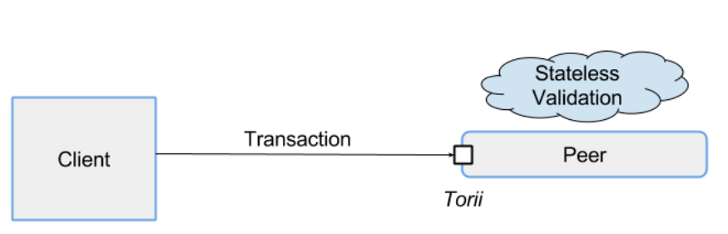
Architectural Flow
Step 1: Client performs transactions and sends to the Torri Gate, which routes the transaction to peer, responsible for performing Stateless Validation

Slide 23
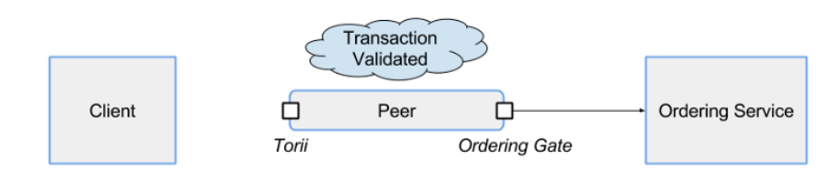
Architectural Flow
Step 2: After the peer performs Stateless Validation, transaction is first send to Ordering Gate which is responsible for choosing the right strategy for connecting the ordering services.

Slide 24
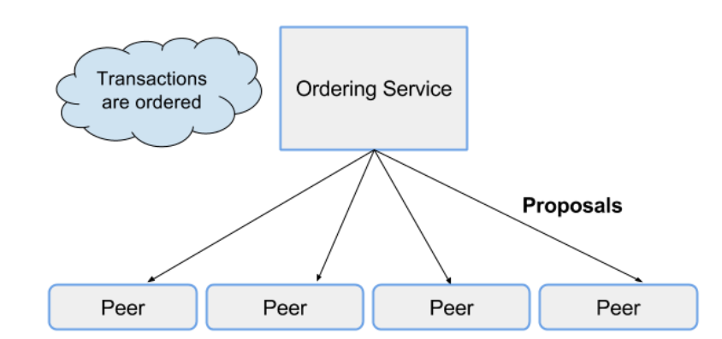
Architectural Flow
Step 3: Ordering service puts transaction into order and forwards them to peer in the Consensus Network in the form of Proposals. Proposal is an unsigned block shared by the ordering services, containing batch of Ordered Transactions

Slide 25
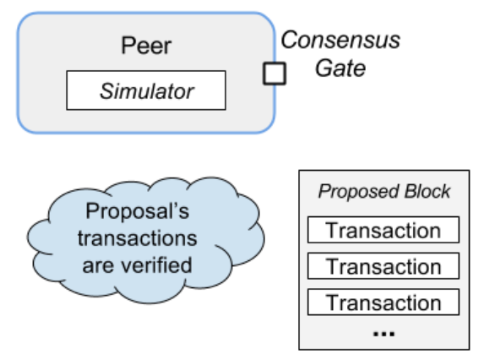
Architectural Flow
Step 4: Each peer verifies the proposal’s content in the simulator and creates a block which consists of verified transactions. Blocks are send to consensus gate which performs YAC Consensus logic

Slide 26
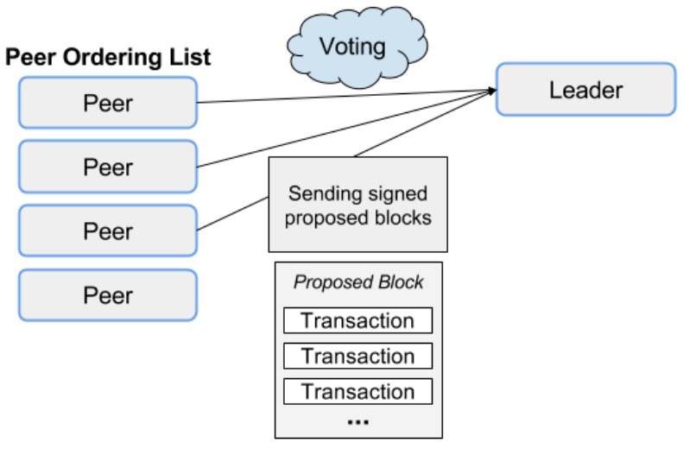
Architectural Flow
Step 5: Order list of peers is determined and a Leader is elected based on the YAC Consensus Logic. Each peer casts a vote by signing and sending their proposed block to leader.

Slide 27
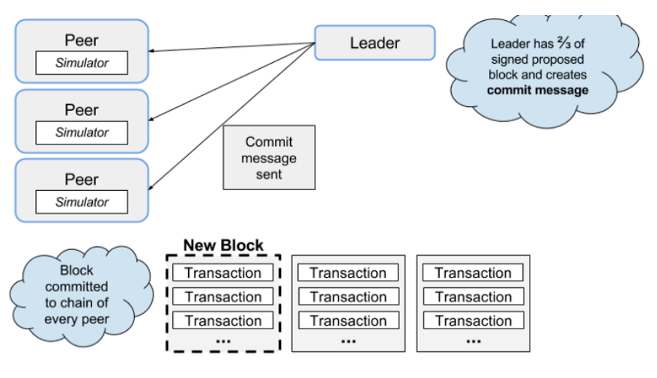
Architectural Flow
Step 6: Once the leader receives enough signed proposed blocks (2/3rd of peers), it starts to send commit message, thus indicating blocks can be added to the database by applying to chain.

Slide 28
Architectural Flow
Once the commit message has been sent, proposed block becomes next block in the chain of every peer via the Synchronizer.

Slide 29
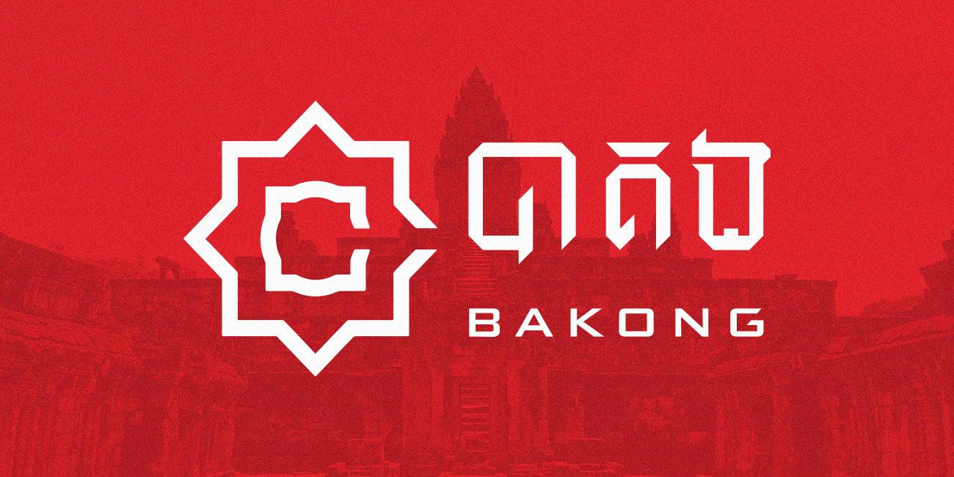

Slide 30

PROJECT BAKONG
Project Initiated and sponsored by the National Bank of Cambodia, the Country’s Central bank.
World’s First Retail Payment Application that uses Blockchain Technology, launched in October, 2020.
Soramitsu, the main contributor to Hyperledger Iroha.
First large-scale Quasi-Central Bank Digital Currency (CBDC).

Slide 31

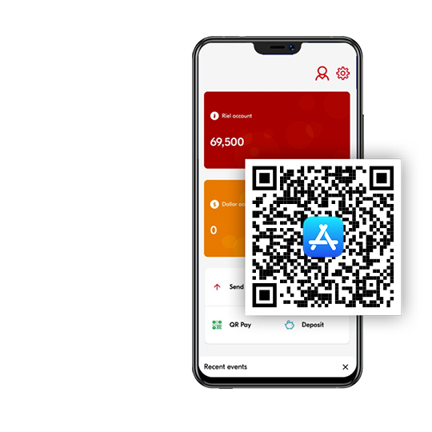
PROJECT BAKONG
NBC, partnered with Blockchain Development Experts, Soramitsu to modernize and digitize the country’s retail payment system with the help of Hyperledger Iroha Blockchain Framework.
BAKONG : First smart step to create fiat-backed Digital Currency, individuals can now transfer money and buy from merchants through mobile application.

Slide 32
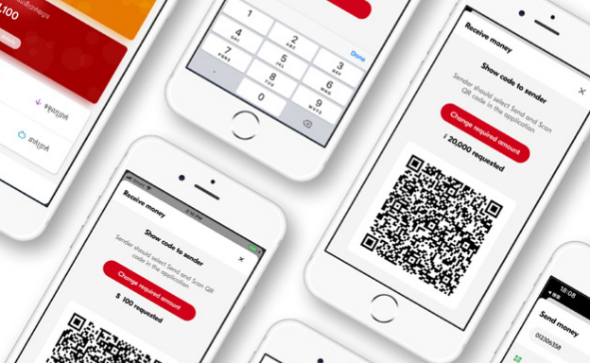

Acknowledging Country’s Banking Issues
In the Kingdom of Cambodia, 2/3rd of population (almost 78%) don’t have access to the bank accounts, still half of the population own a smartphone.
Even though the native currency of Cambodia is Khmer reil (KHR), most of the people there use the American Dollar. Price of everything from a cup of coffee to a car has been evaluated in terms of U.S Dollar. Thus, NBC want to “De-Dollarize” the retail segments and regain the control over Country’s Currency.

Slide 33
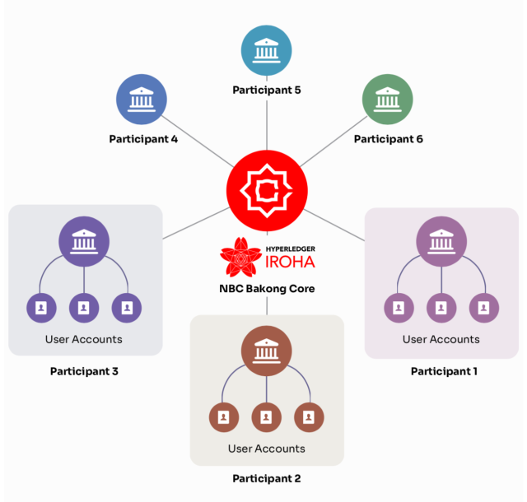
PROJECT BAKONG

Slide 34
Bibliography
Read the Documentation
https://iroha.readthedocs.io/en/main/overview.html
Architecture
https://wiki.hyperledger.org/display/iroha/Architecture
Soramitsu Case Study on Bakong
https://www.hyperledger.org/learn/publications/soramitsu-case-study
Hyperledger Iroha : getting started guide
https://www.srcmake.com/home/iroha-tutorial
Bakong
https://bakong.nbc.org.kh/en/

Slide 35
Thank You…

